Slide 1
Image2Code
5/Jun/2019

Slide 2
Contents
What is this?
Problem Statement
Progress
Current Results

Slide 3


What is this?
User Scenario 1
Let’s make a FANCY website!!!
Why not? You aren’t the one who writes code
John – Designer
Know nothing about coding
Bob – Web Developer
Care about nothing except coding

Slide 4
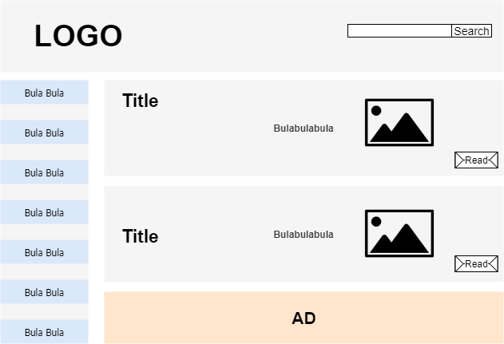
What is this?
User Scenario 1
This is my genius design !!!
John – Designer
Know nothing about coding
Image Prototype

Slide 5
What is this?
User Scenario 1
Okay, I will spend four days to transform this into code
Bob – Web Developer
Care about nothing except coding
Image Prototype

Slide 6
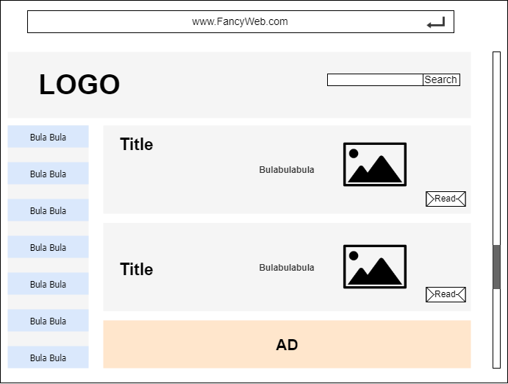

What is this?
User Scenario 1
OR, I can take several SECONDS to do so by using the
IMG2CODE
Bob – Web Developer
Care about nothing except coding
Working Static Webpage

Slide 7
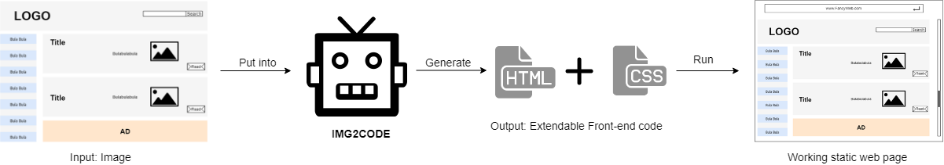
What is this?
User Scenario 1: Image Design to Code

Slide 8
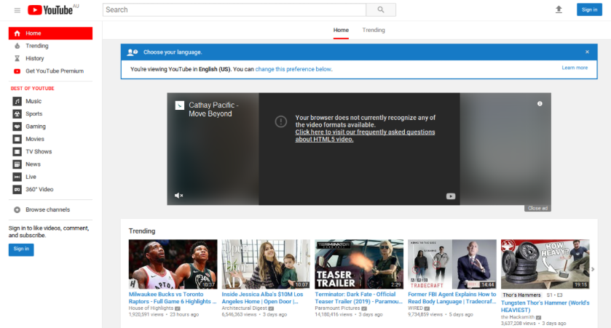
What is this?
User Scenario 2
Let me check Youtube
I want to develop a video website, but I don’t have any clue
Bob – Web Developer
Care about nothing except coding

Slide 9
What is this?
User Scenario 2
This is what I want !!!
It would be perfect if I can have the similar design style !!!
Bob – Web Developer
Care about nothing except coding

Slide 10
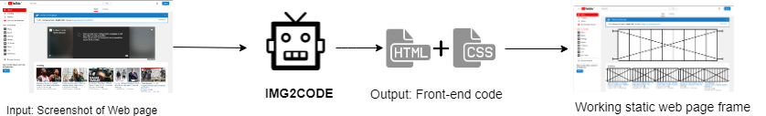
What is this?
User Scenario 2: Screenshot to Code – Partial UI Reuse

Slide 11

Problem Statement
Final Goal
Generate the front-end CODE from any given web page IMAGE

Slide 12
Problem Statement
Final Goal
Generate the front-end CODE from any given web page IMAGE
Sub Goals
1. Detect and classify UI components (Button, Text, Image) on the input image
2. Reversely generate usable front-end code (HTML, CSS)

Slide 13
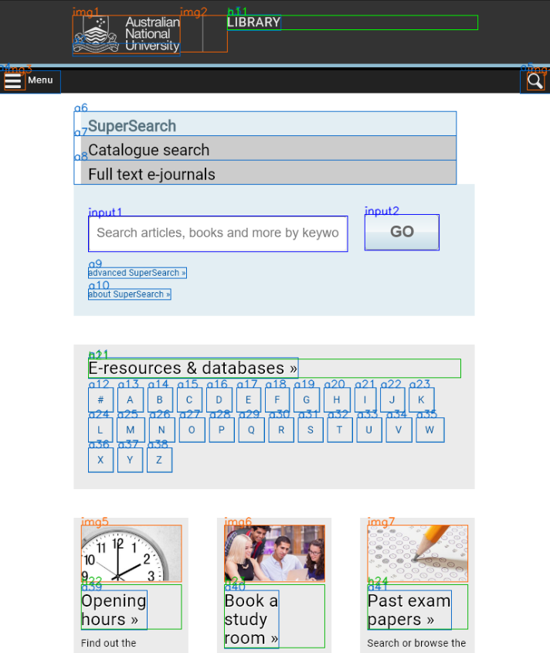
Problem Statement
UI Components Detection and Classification
Tricky problem: Efficient detection of simple UI components

Slide 14

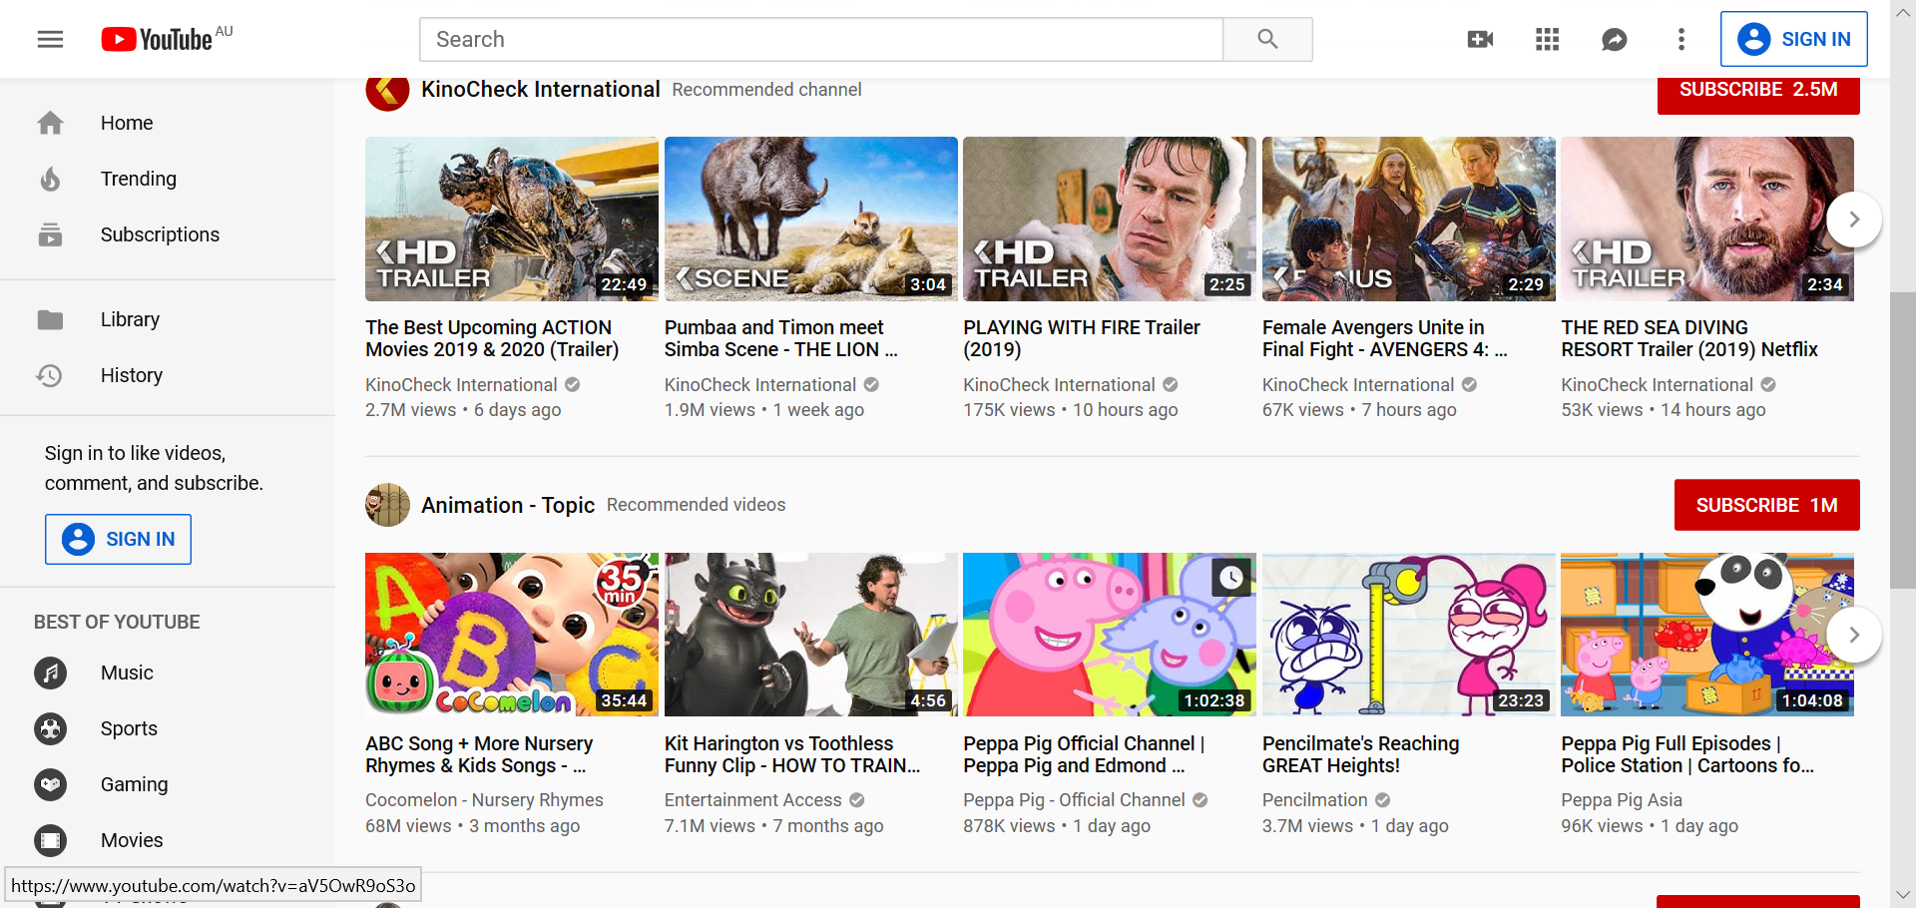
Problem Statement
UI Components Detection and Classification
Tricky problem: Misrecognize contents of the <img> as the web components.

Slide 15
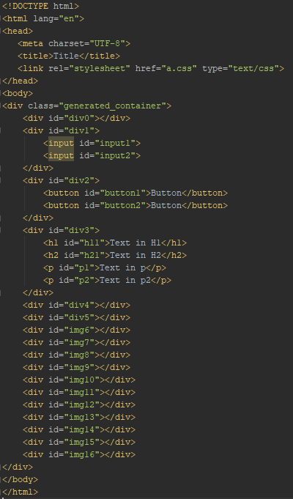
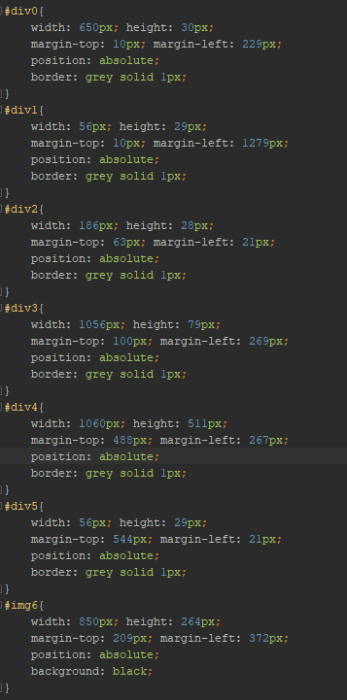
Problem Statement
Maintainable Code Generating
Tricky problem: Make generated code easy to edit and extend.

Slide 16
Progress
Attempts on UI Components Detection and Classification
1. End-to-End: Deep Learning
Objection detection method
2. Divide and Conquer: Image Processing + Machine Learning
Decompose elements and Classify them

Slide 17
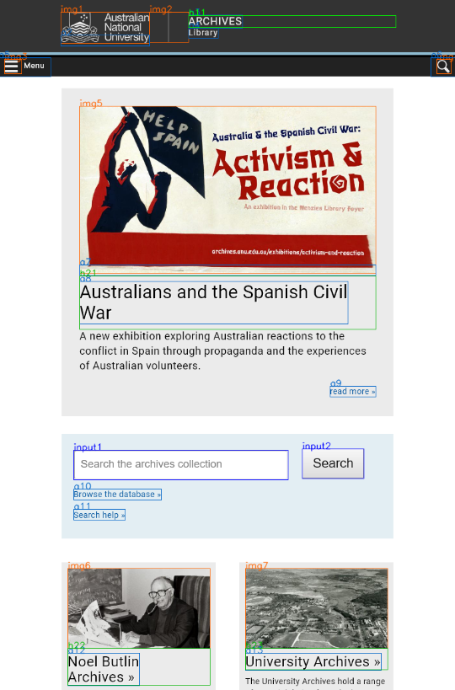
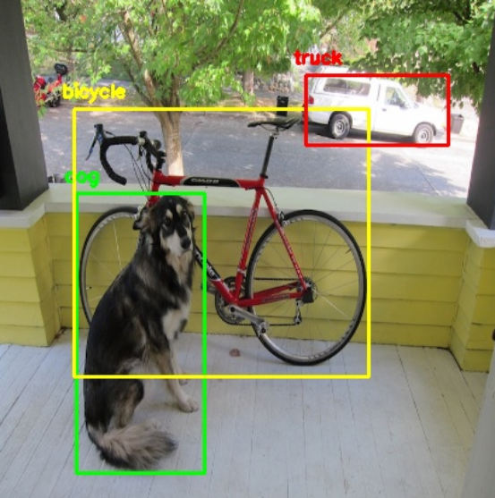
Progress
End-to-End (Deep Learning)
Refer to the Objection Detection Method

Slide 18

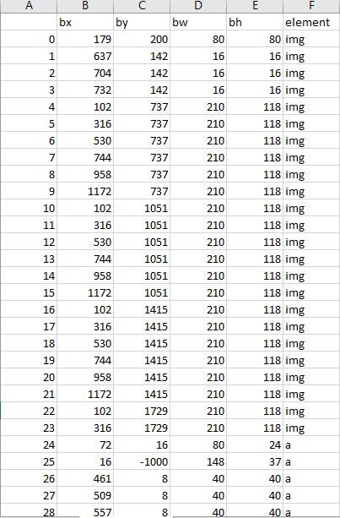
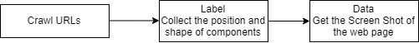
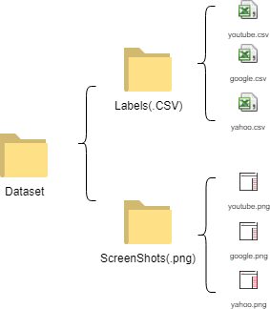
Progress
End-to-End (Deep Learning)
Dataset Collection

Slide 19
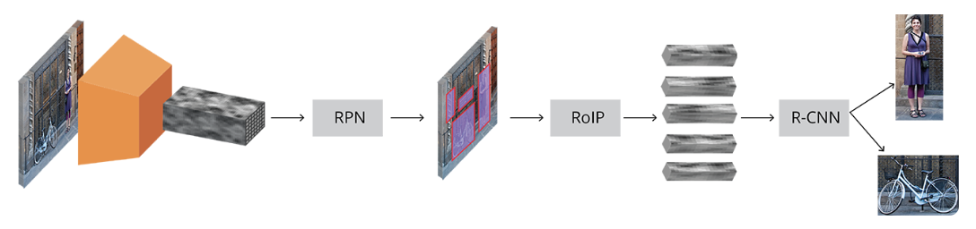
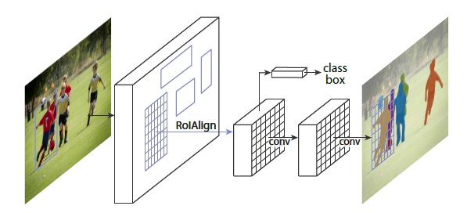
Progress
End-to-End (Deep Learning)
Model Selection
1. YOLO v3
2. Faster RCNN
3. Mask RCNN
Faster RCNN
Mask RCNN

Slide 20
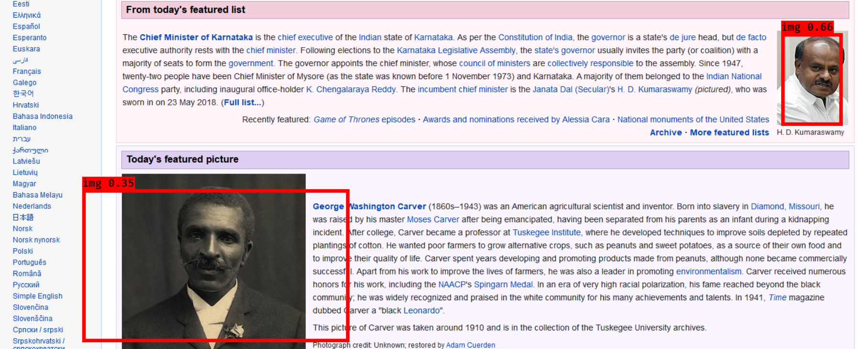
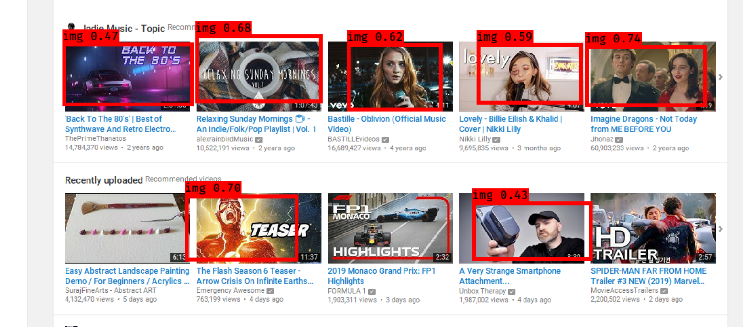
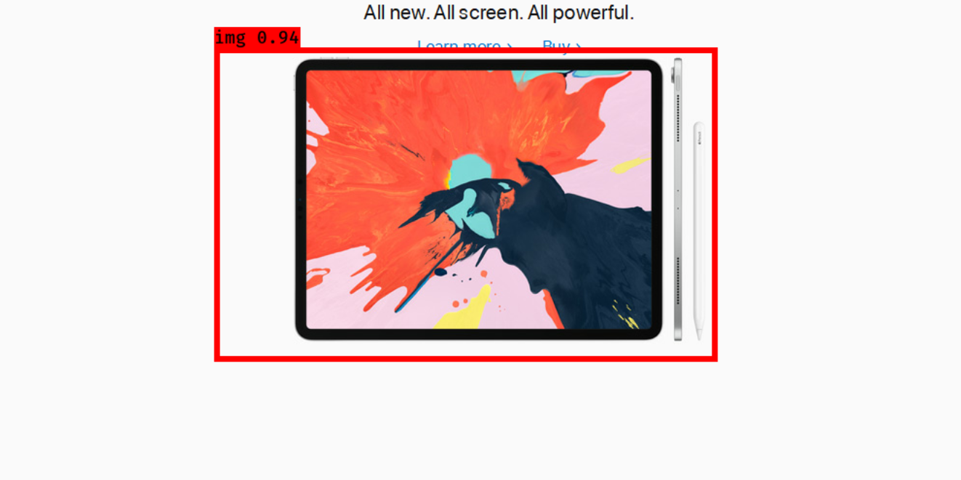
Progress
End-to-End (Deep Learning)
Experiment:
YOLOv3 + VGG16 (Base Net)
Trained on 1200 Images

Slide 21
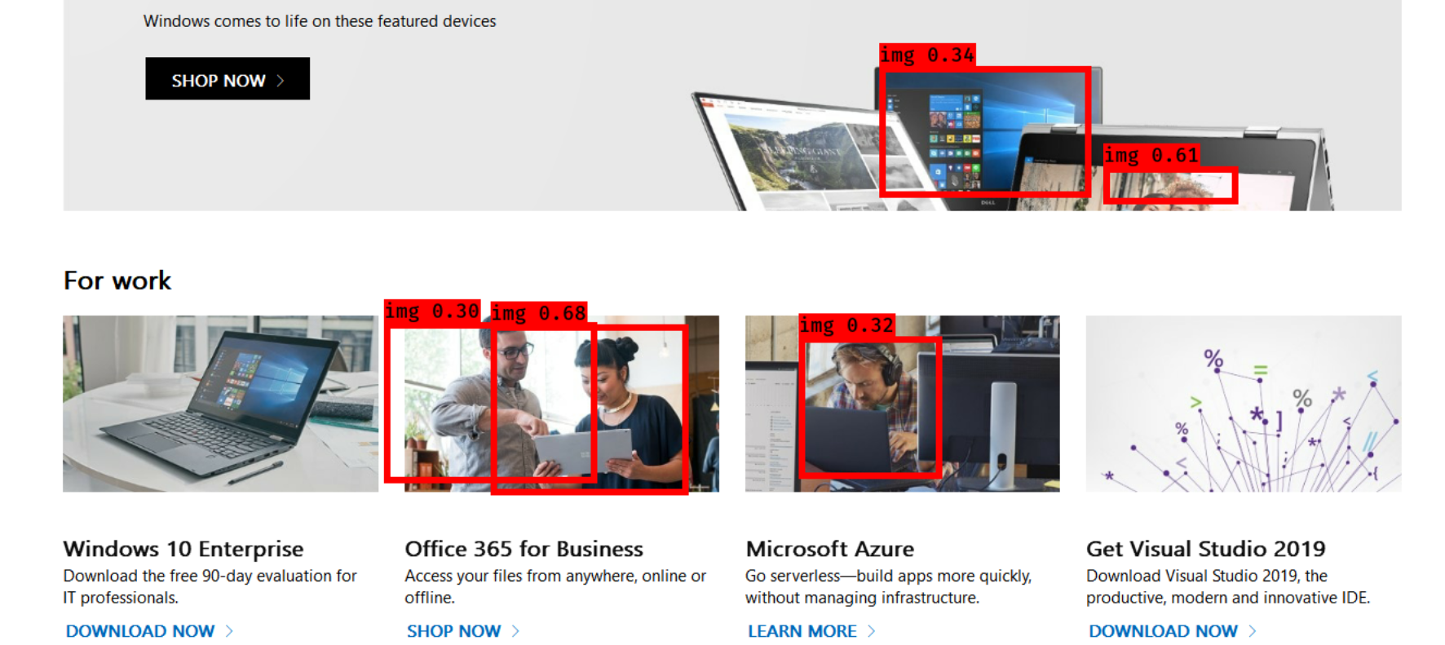
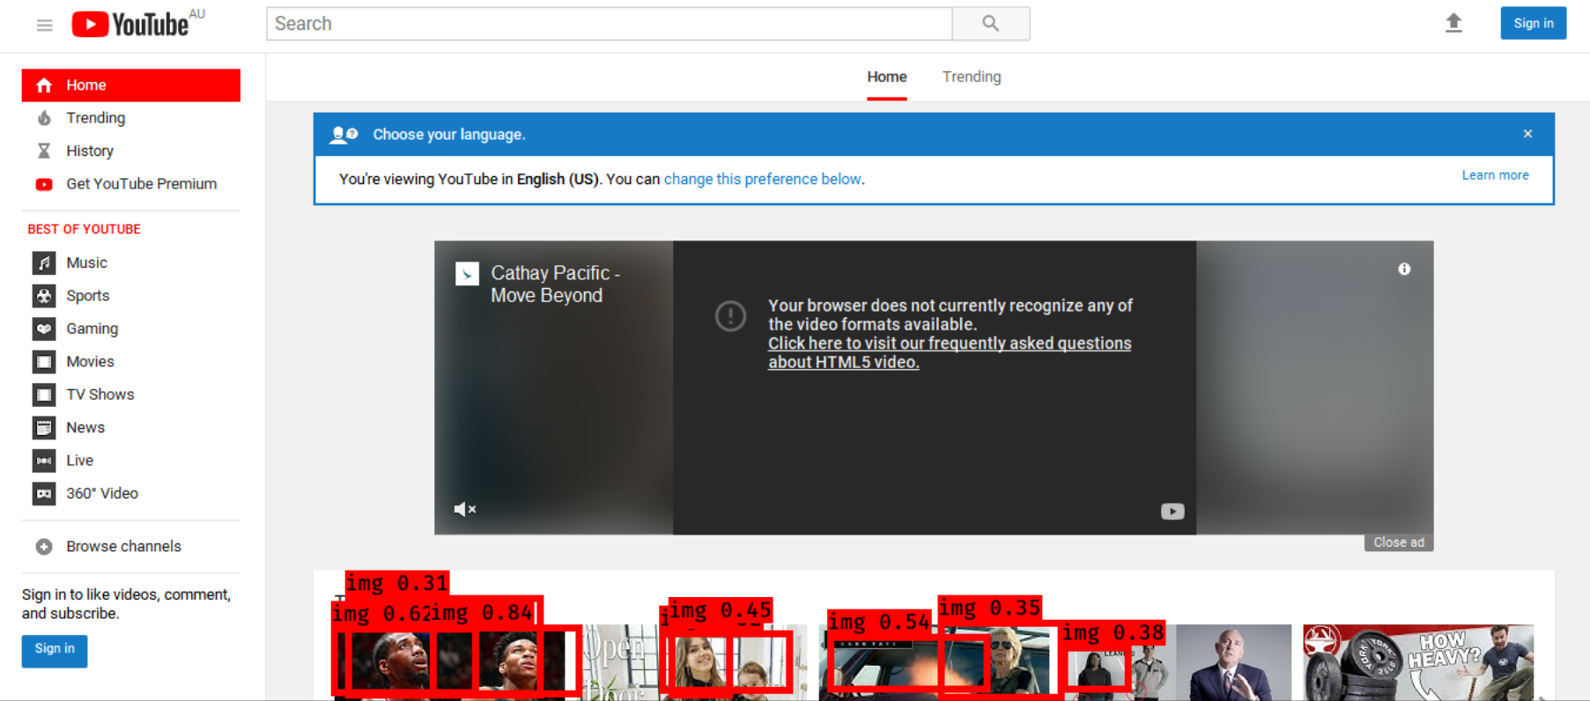
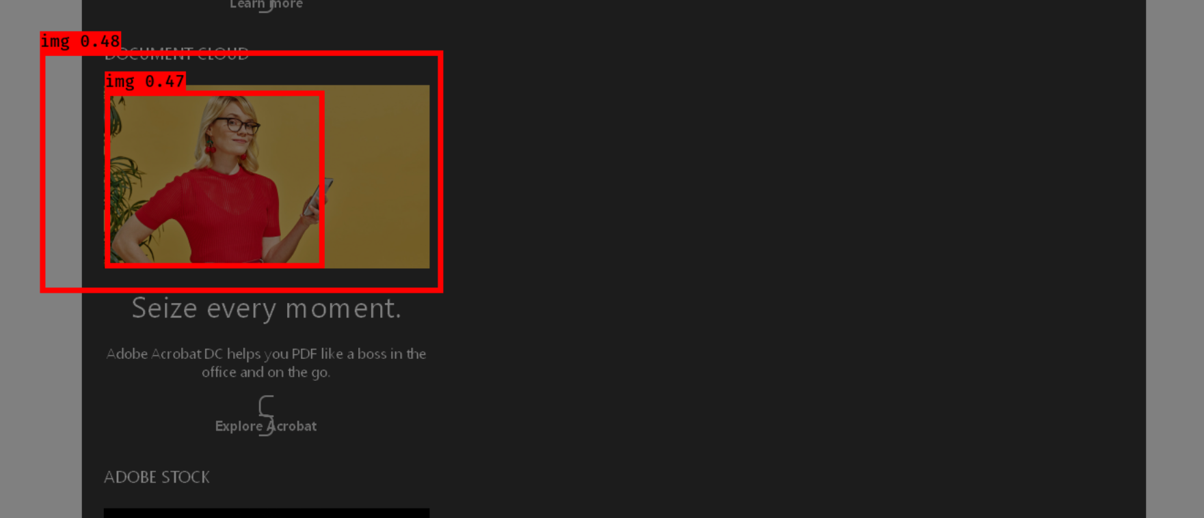
Progress
End-to-End (Deep Learning)
Experiment:
YOLOv3 + VGG16 (Base Net)
Trained on 1200 Images

Slide 22
Progress
End-to-End (Deep Learning)
Issues:
1. Hard to predict the accurate position of elements
2. Susceptible to the complex image elements on the screenshot

Slide 23
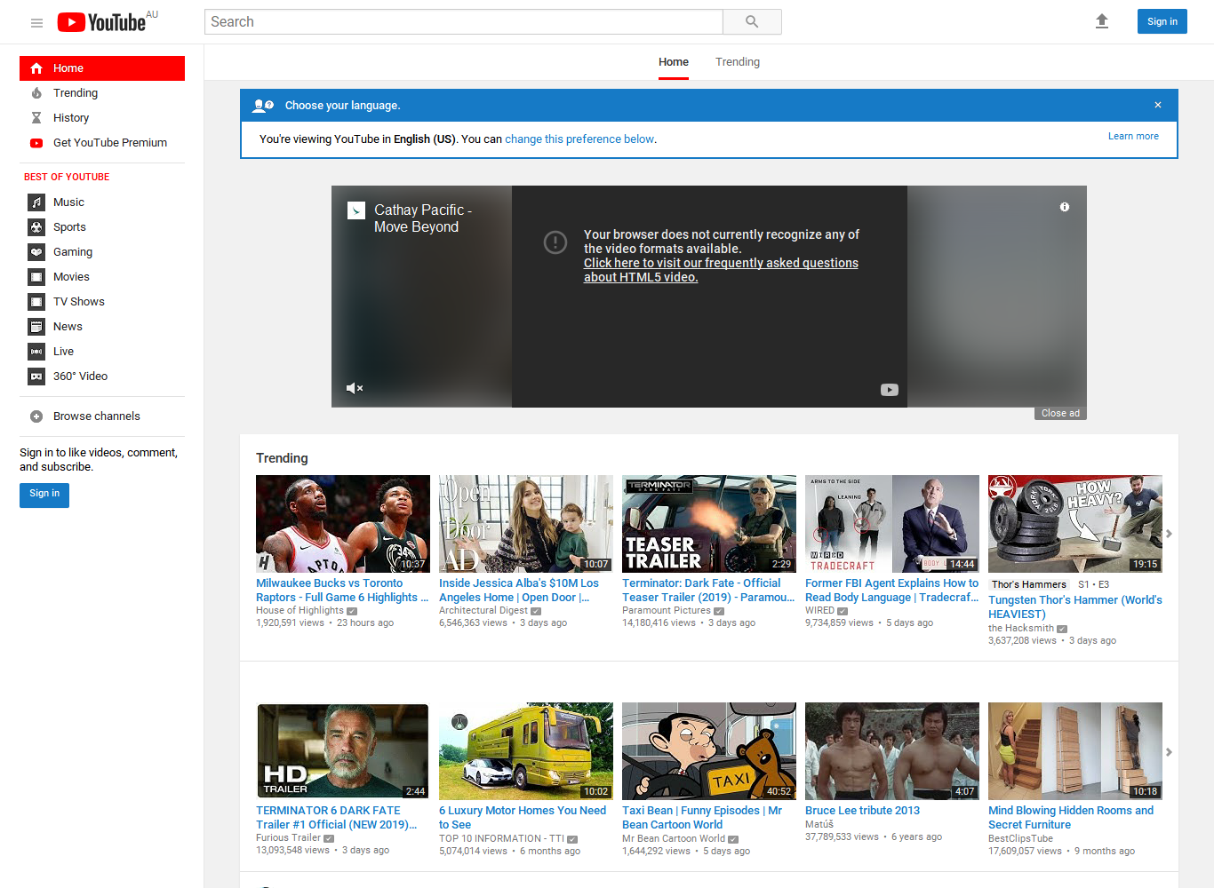
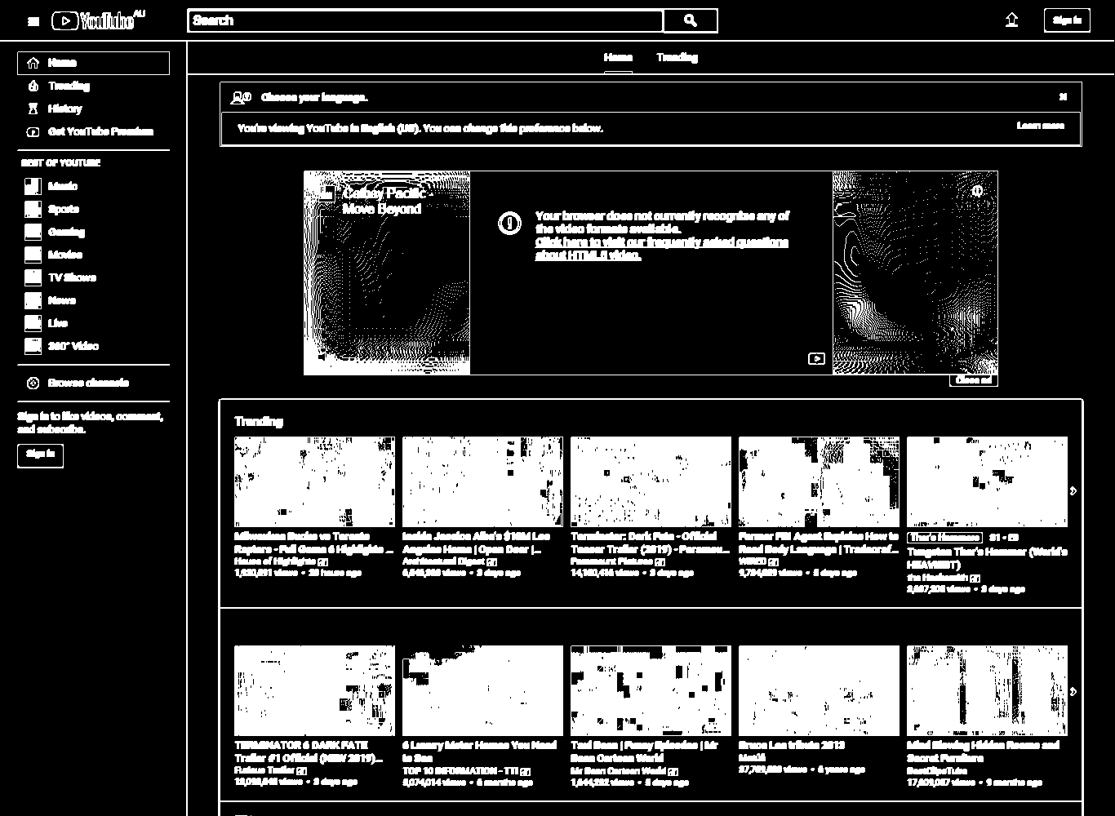
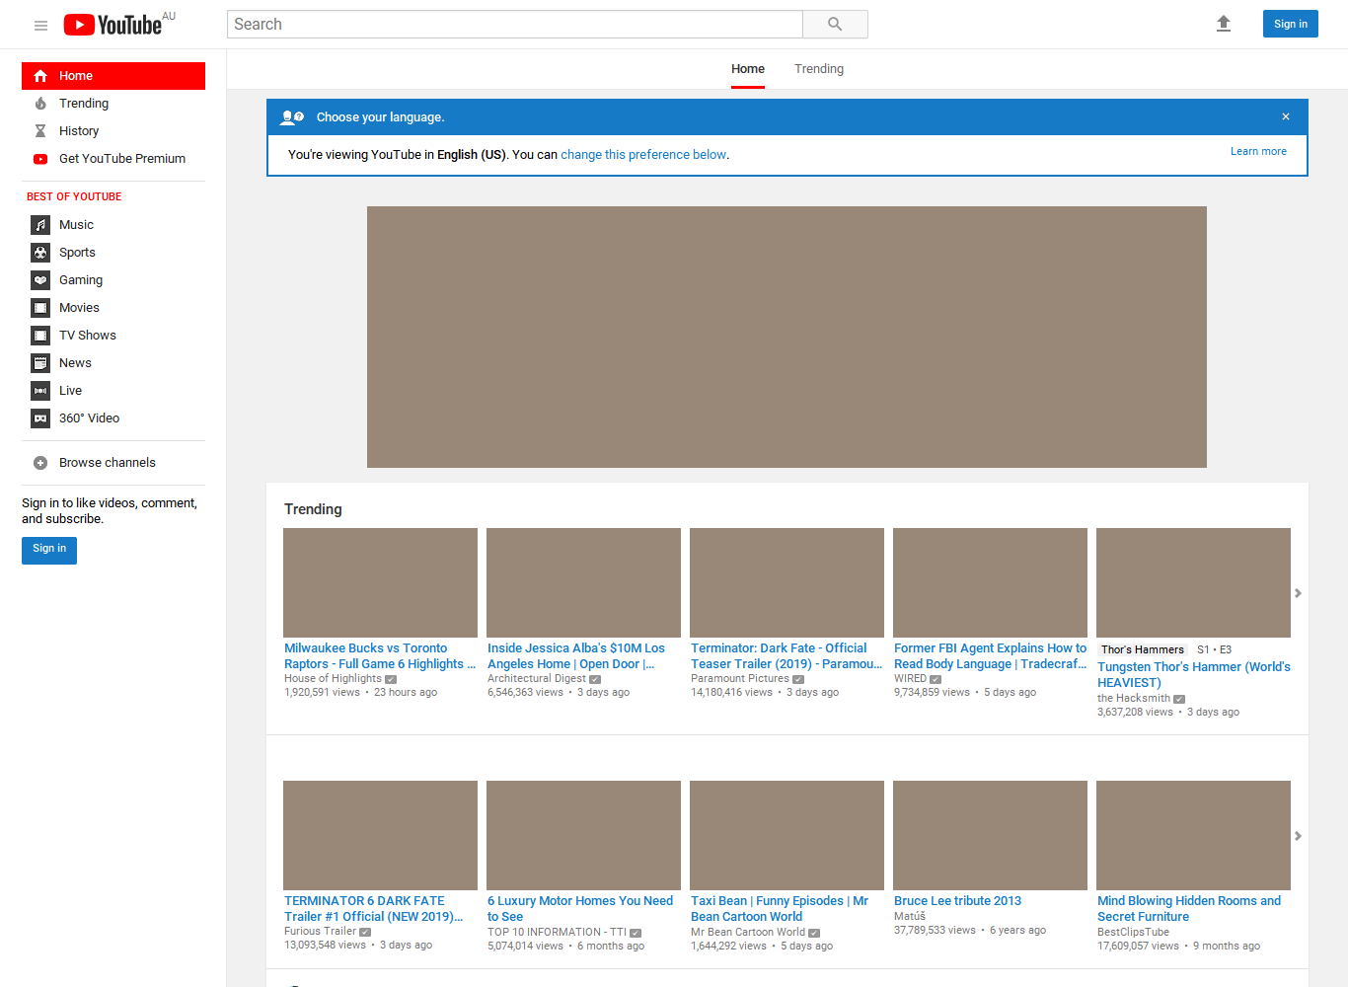
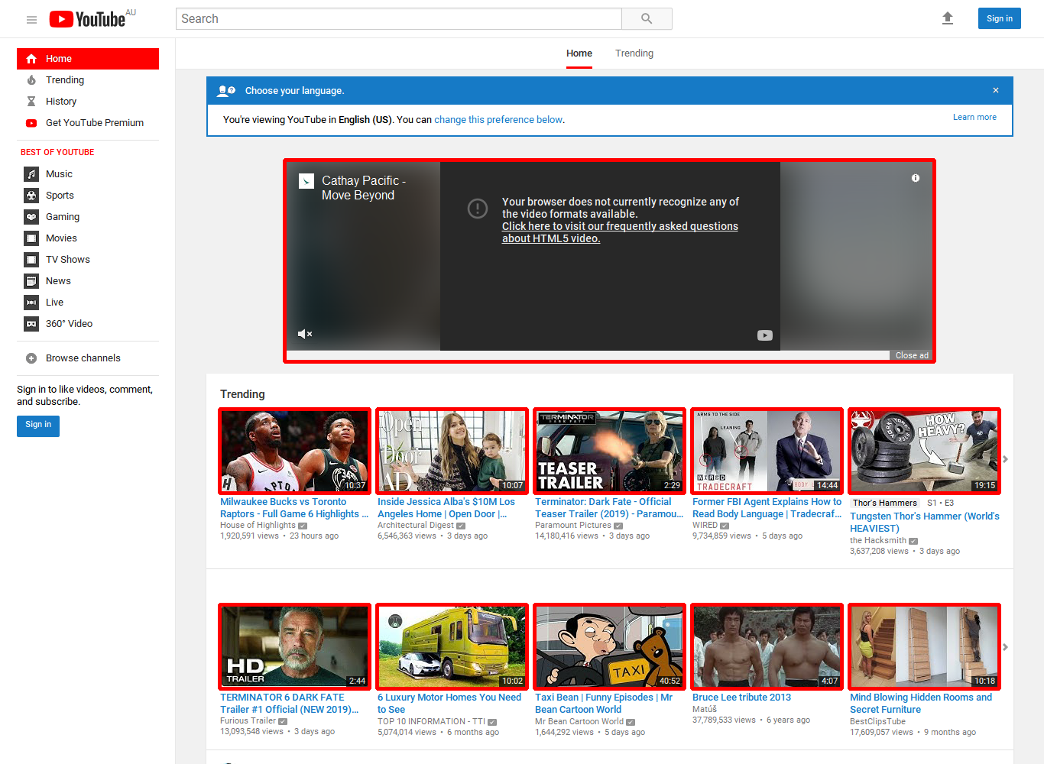
Progress
Divide and Conquer (Computer Vision)
Process:
1. Detect and Separate the <image> components on the screenshot first
2. Classify the other UI components

Slide 24
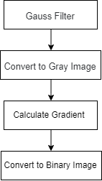
Progress
Divide and Conquer (Computer Vision)
<Img> Detection:
Original Image Processing Algorithms
Pre-processing

Slide 25
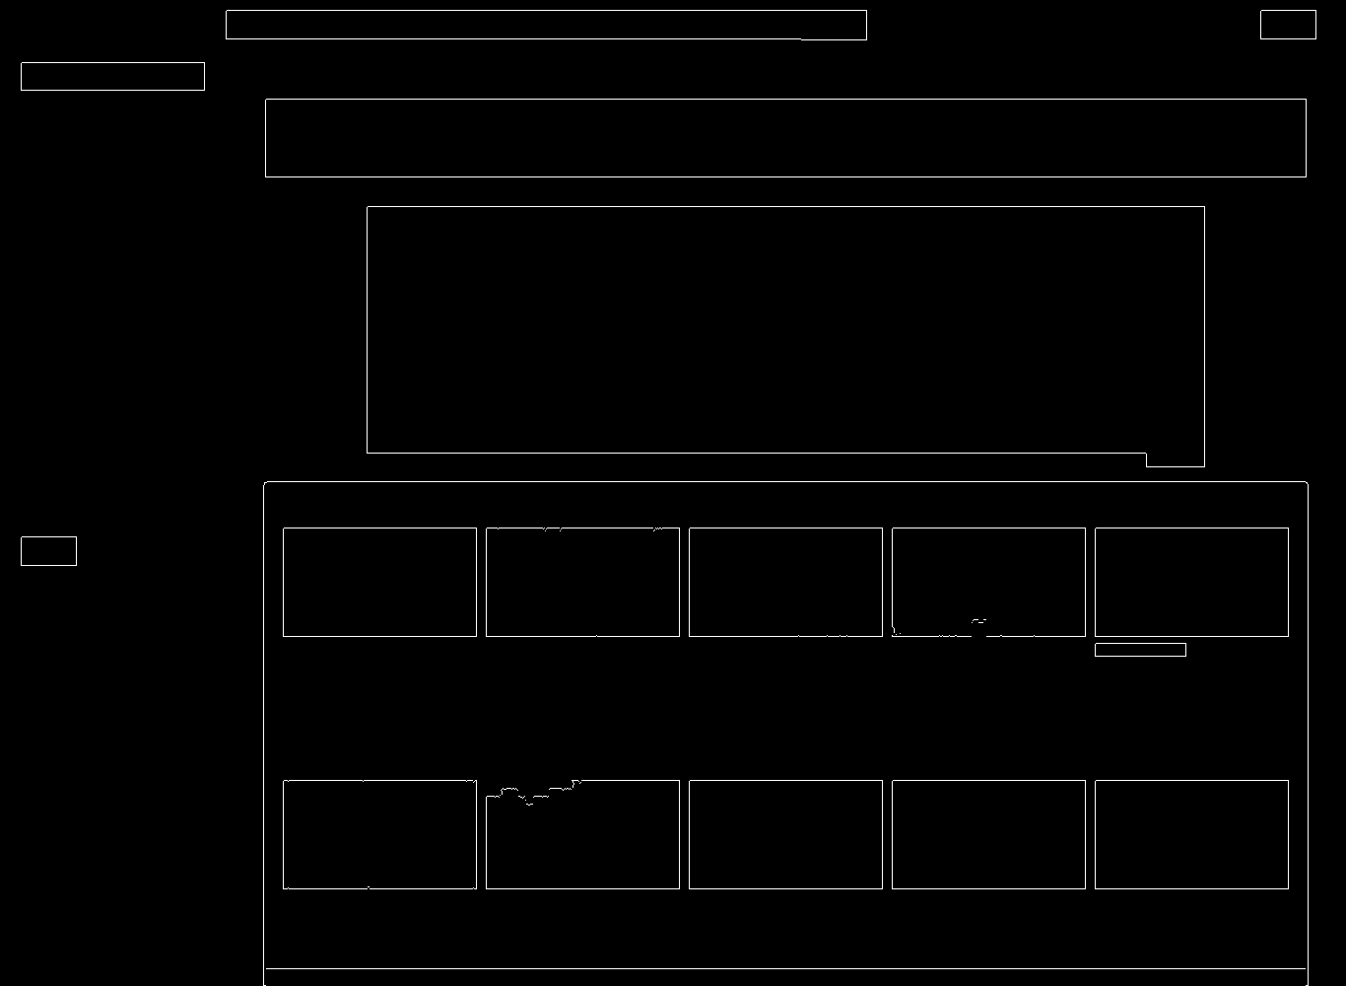
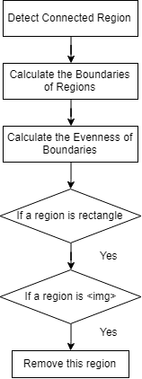
Progress
Divide and Conquer (Computer Vision)
<Img> Detection:
Original Image Processing Algorithms
Region processing

Slide 26
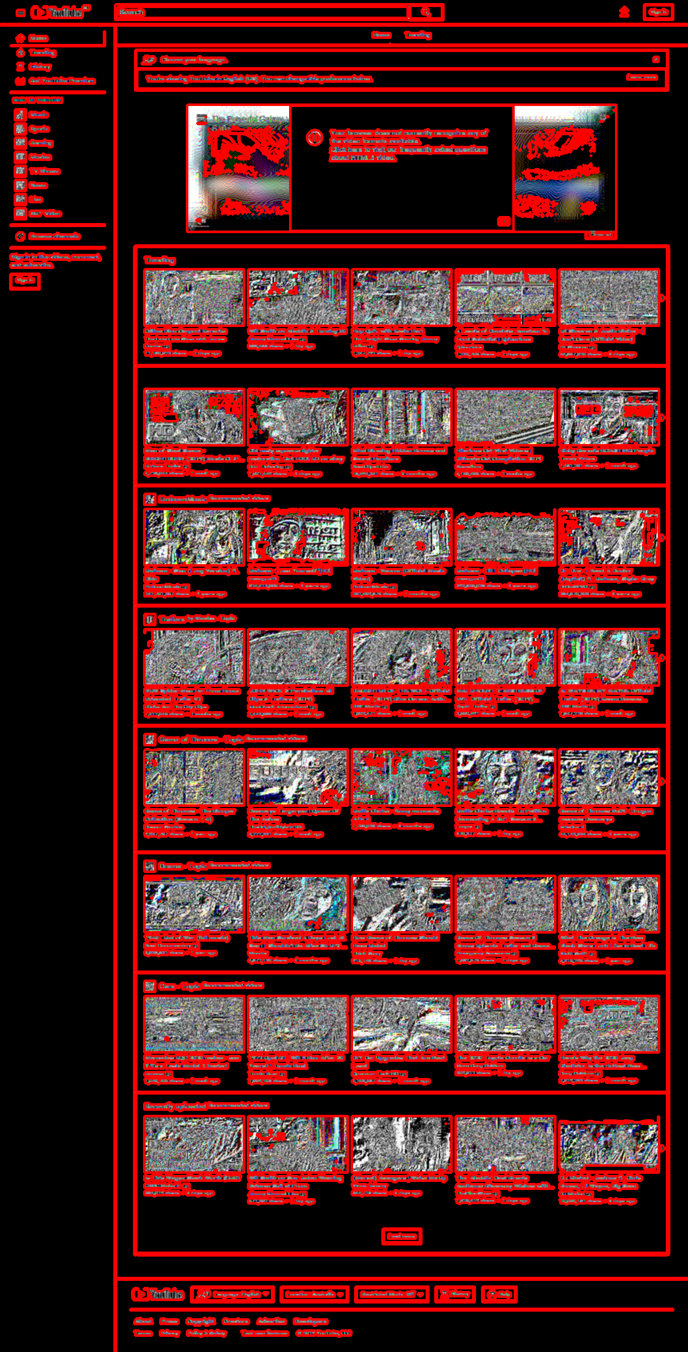
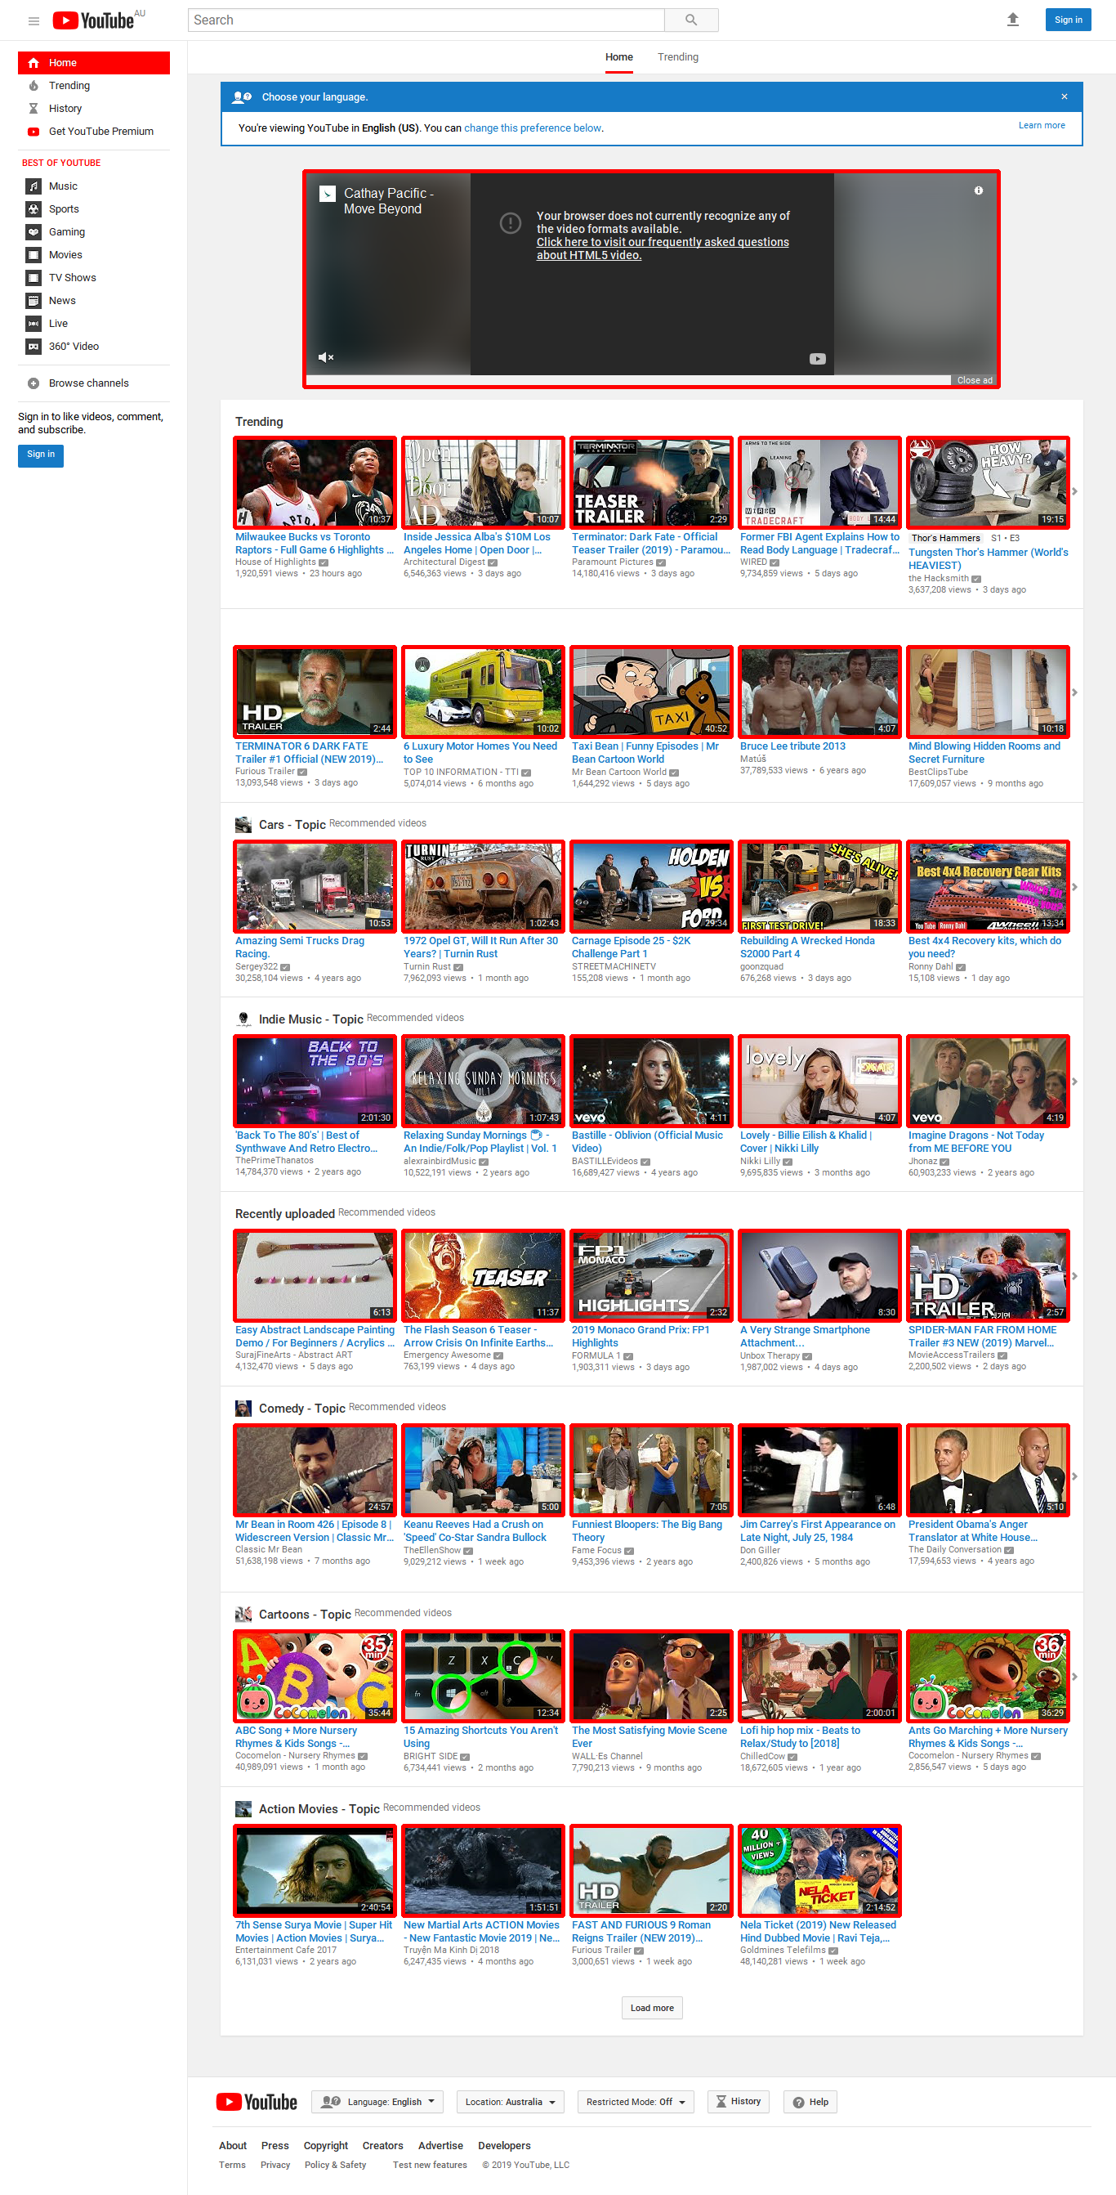
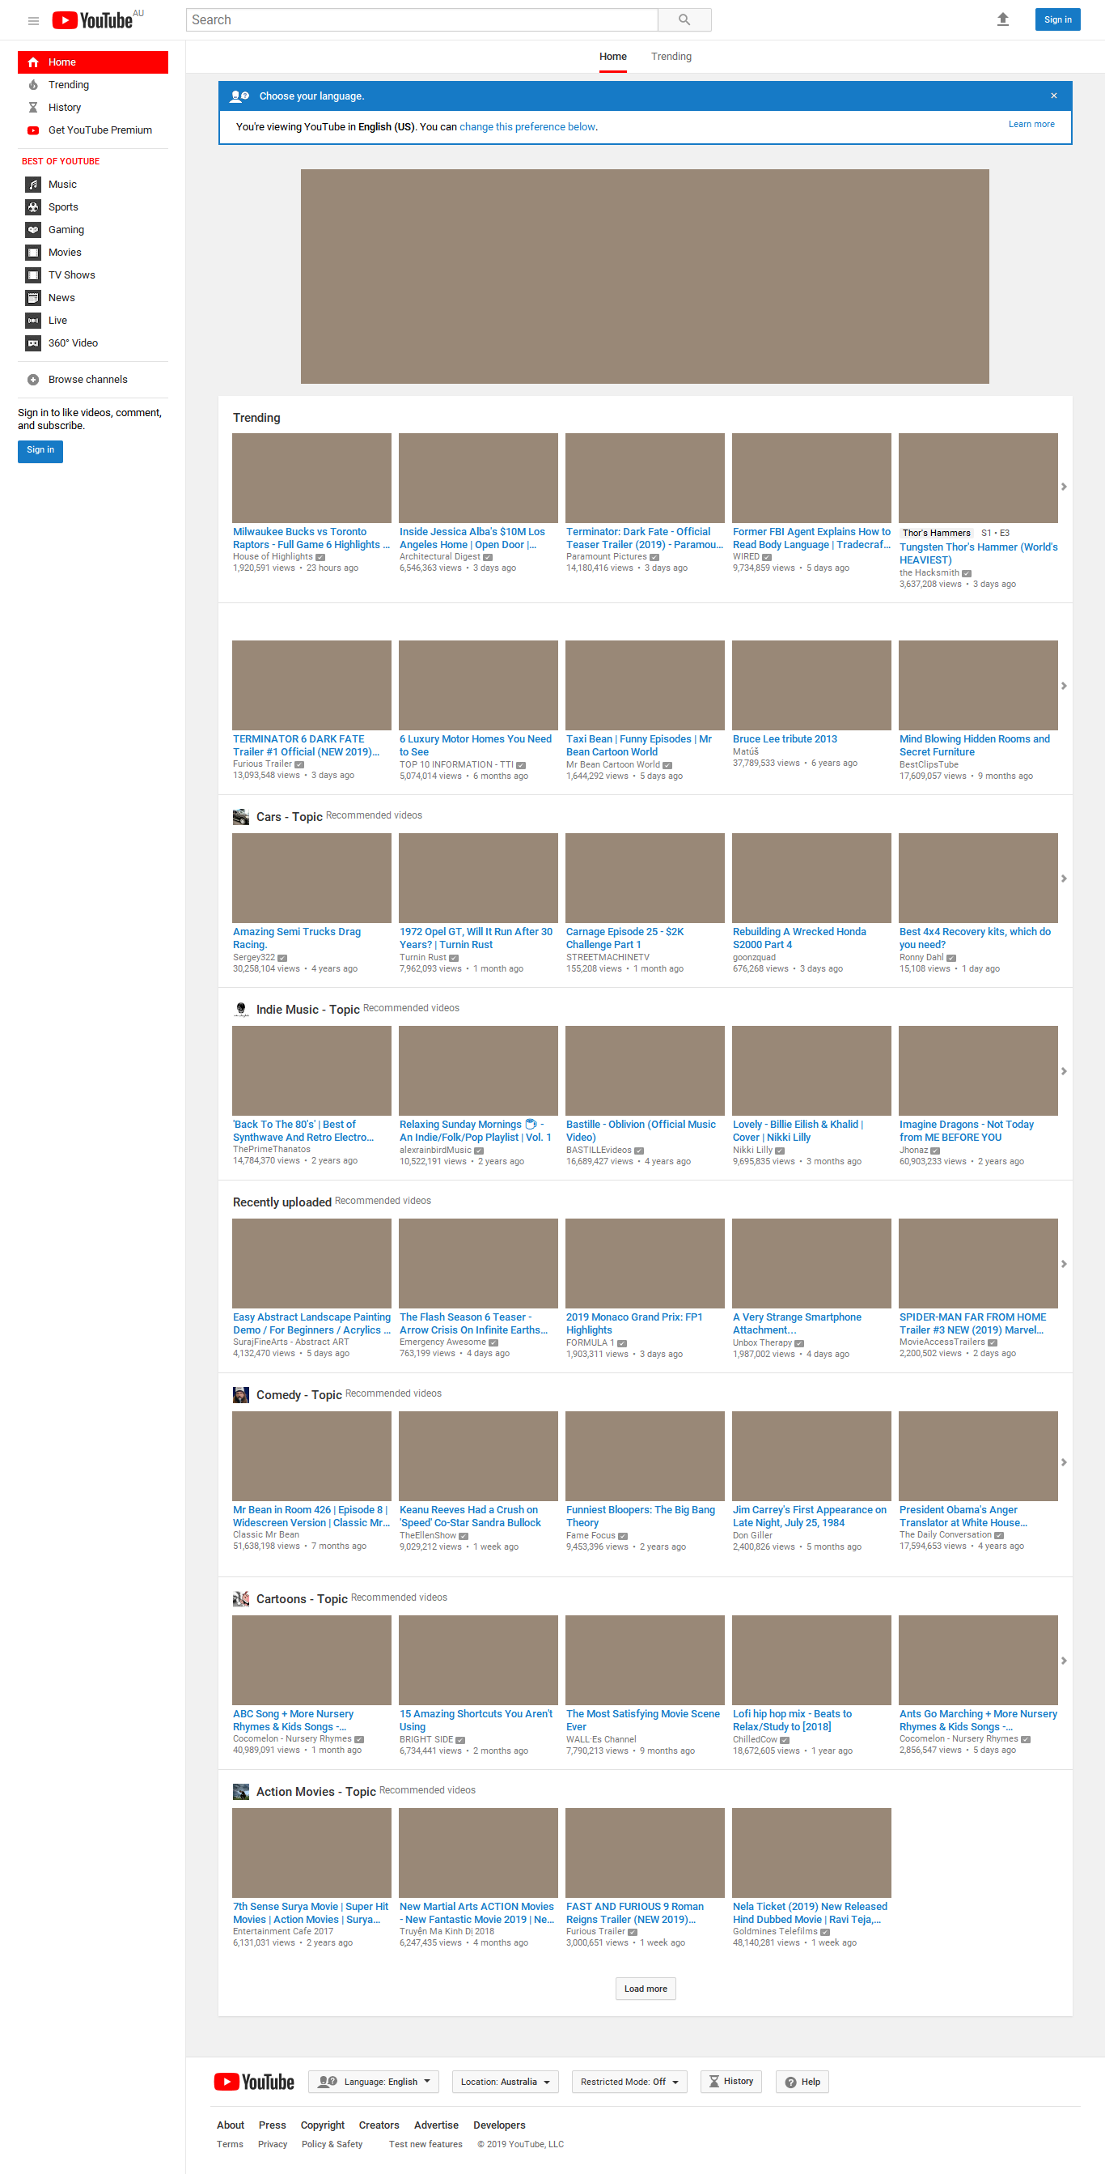
Progress
Divide and Conquer (Computer Vision)
<Img> Detection:
Original Image Processing Algorithms

Slide 27
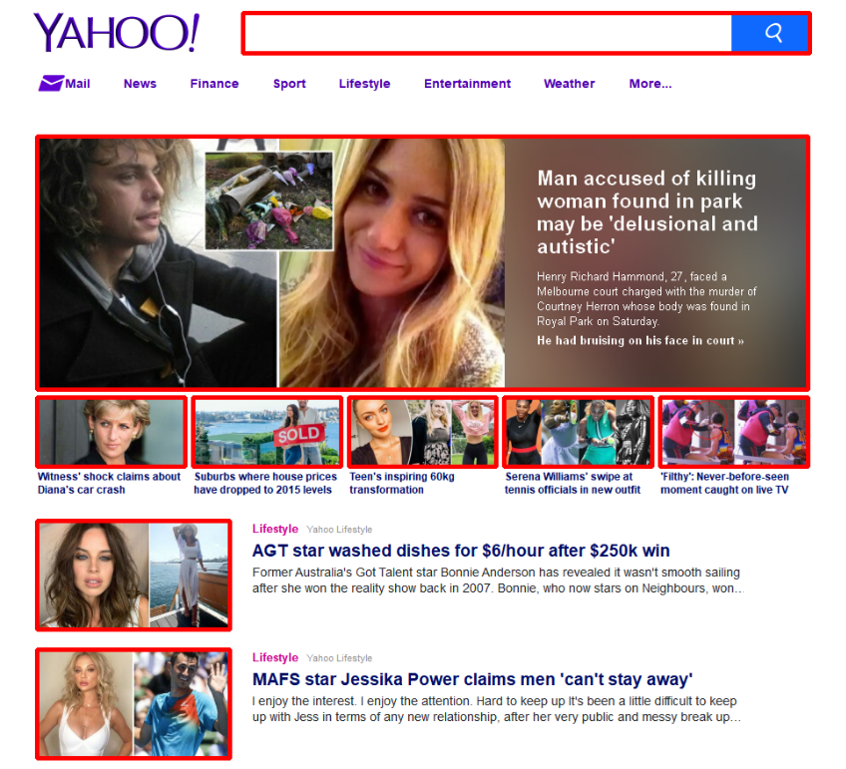
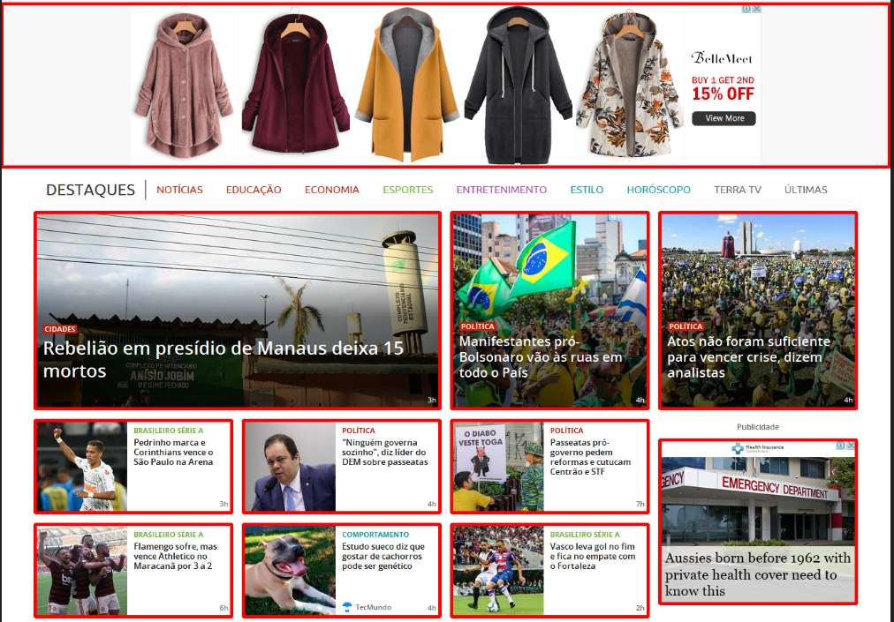
Results
Image Detection

Slide 28
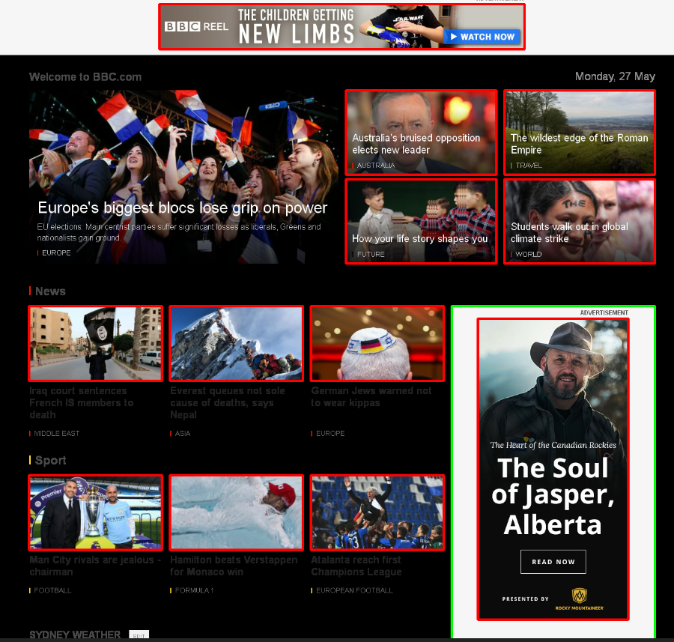
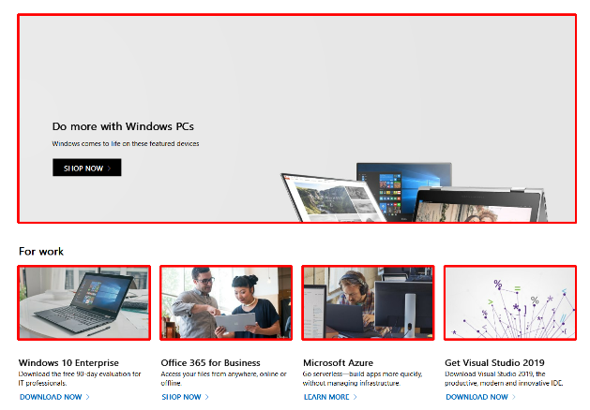
Results
Image Detection

Slide 29
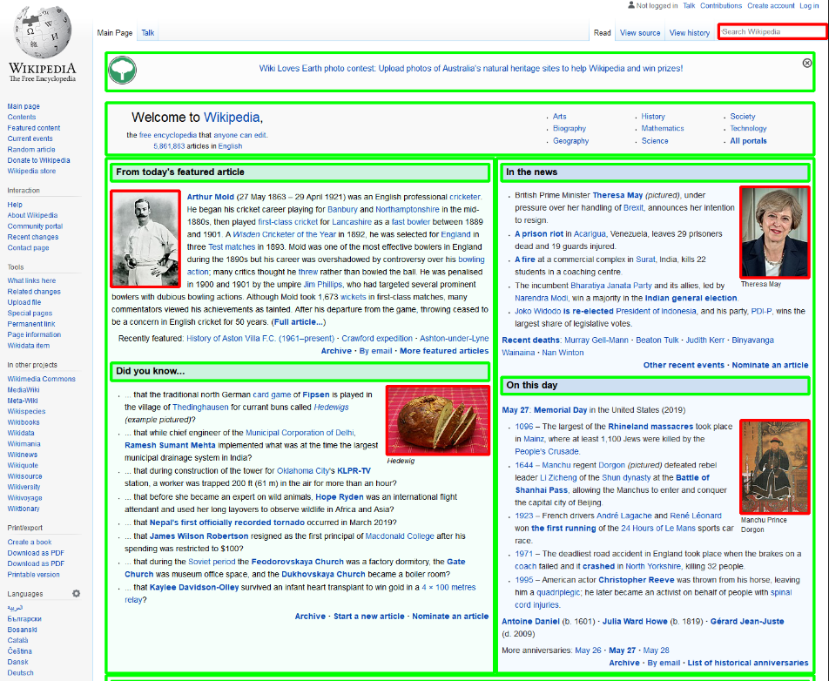
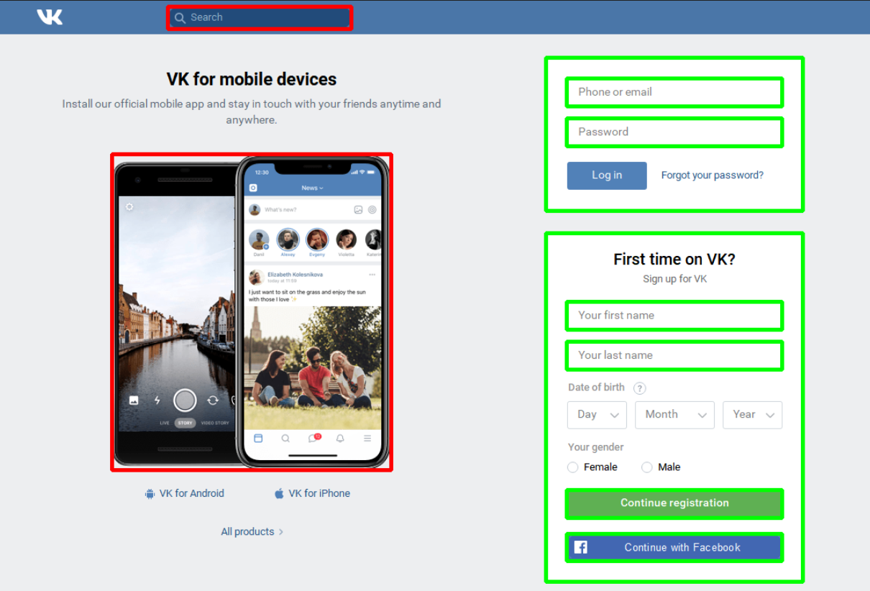
Results
Image Detection

Slide 30
Results
Code Generation

Slide 31
Future Work
Image Processing
UI components detection and classification
Text font classification
Code Generation
Extendable and maintainable code
Fit to real developer’s usual practice

